Slide 1
CS213 Recitation 6
Notes:
Hello, everyone. In today’s recitation, let’s go over some knowledge points about Java I/O and JavaFX Basics.

Slide 2
I/O
JavaFX Basics
JavaFX Program Structure
Notes:
These are the contents we will cover today.

Slide 3
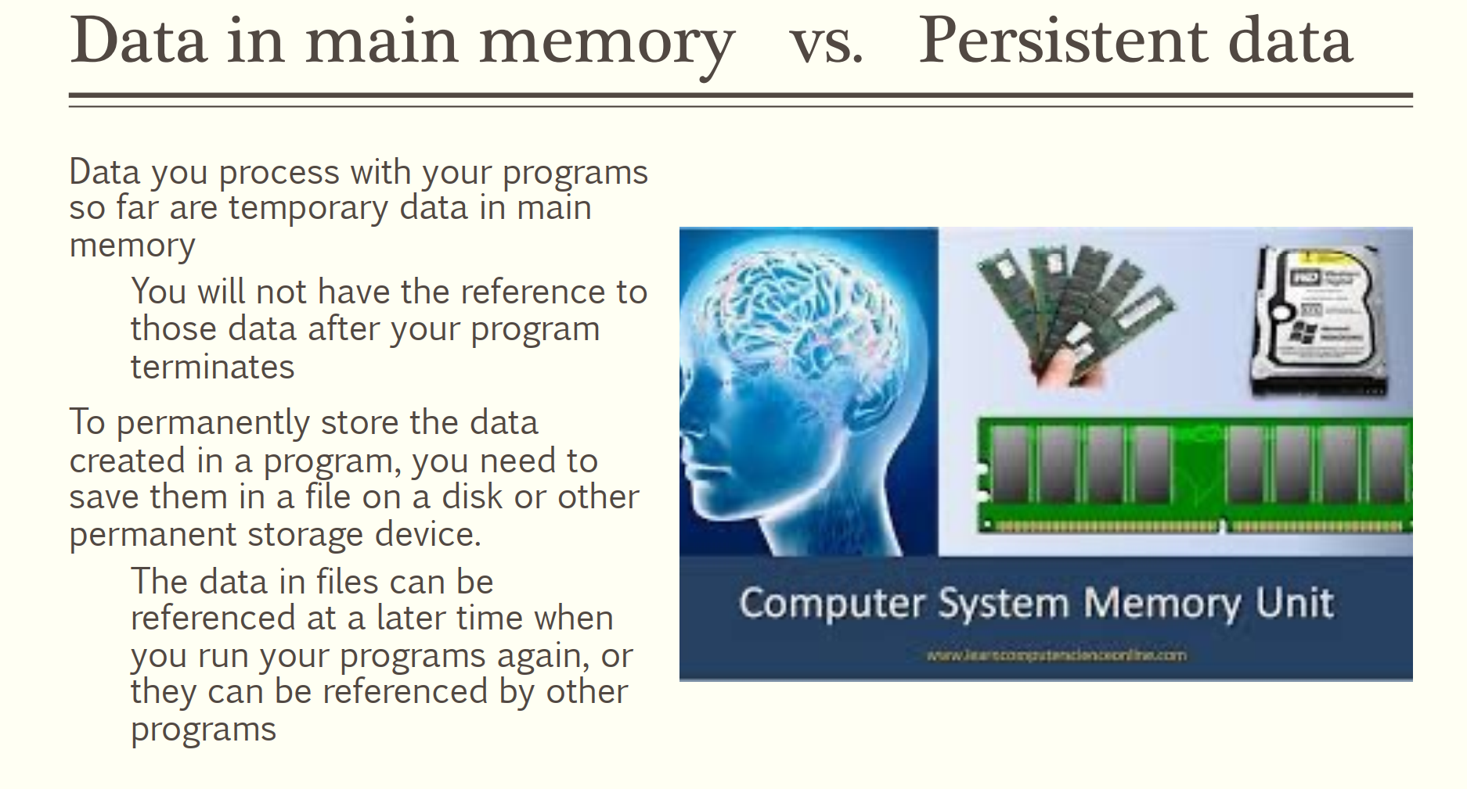
Notes:
Firstly, the difference between data in main memory and persistent data.

Slide 4
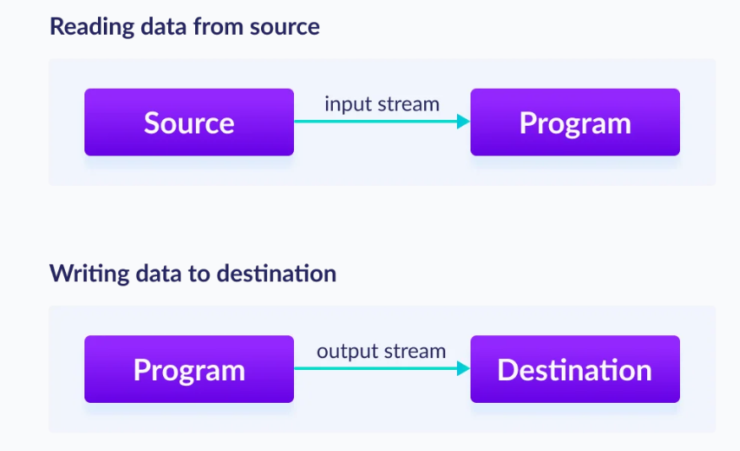
Notes:
To read data form source, you need to set up an input stream from the source of data to the program.

Slide 5
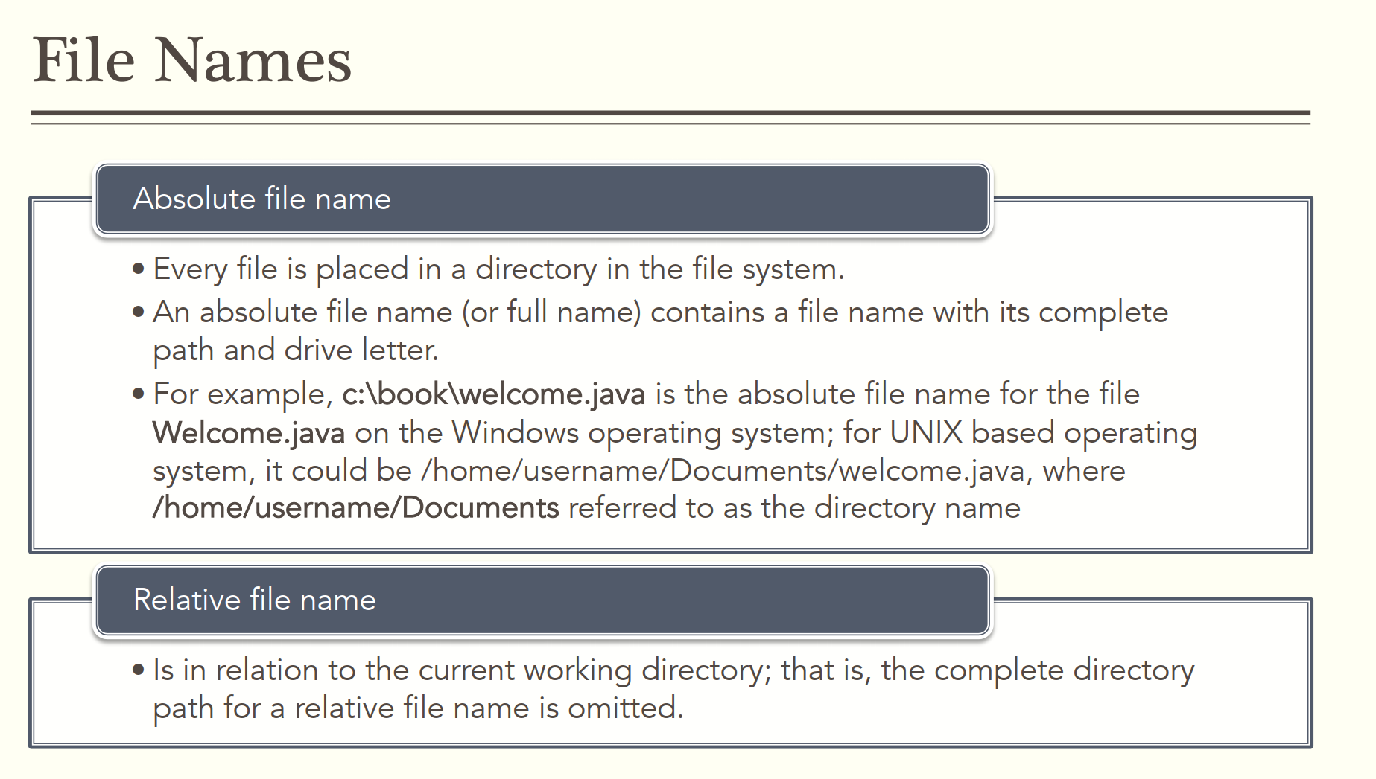
Notes:
The source of data can be a file. We need to use file name to identify a file.
File name can be divided into absolute file name and relative file name.

Slide 6
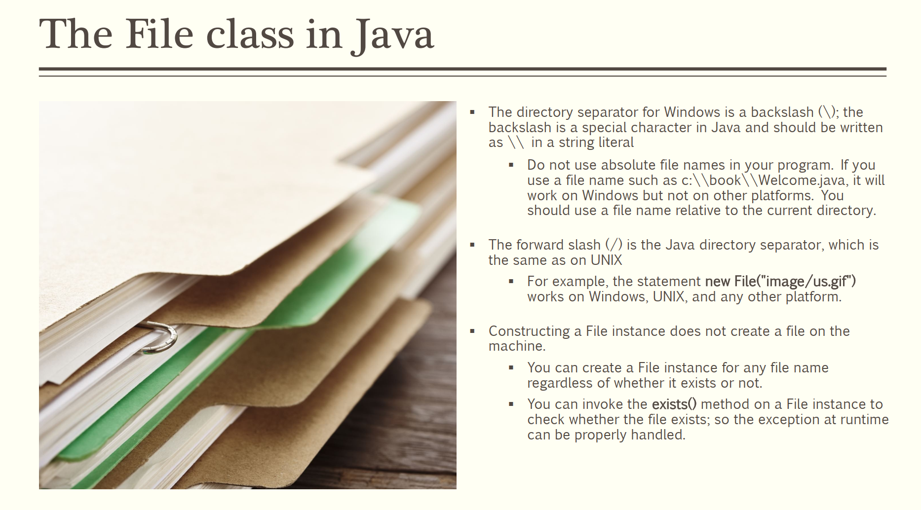
Notes:
In Java, we need to use FIle class to represent a file.

Slide 7
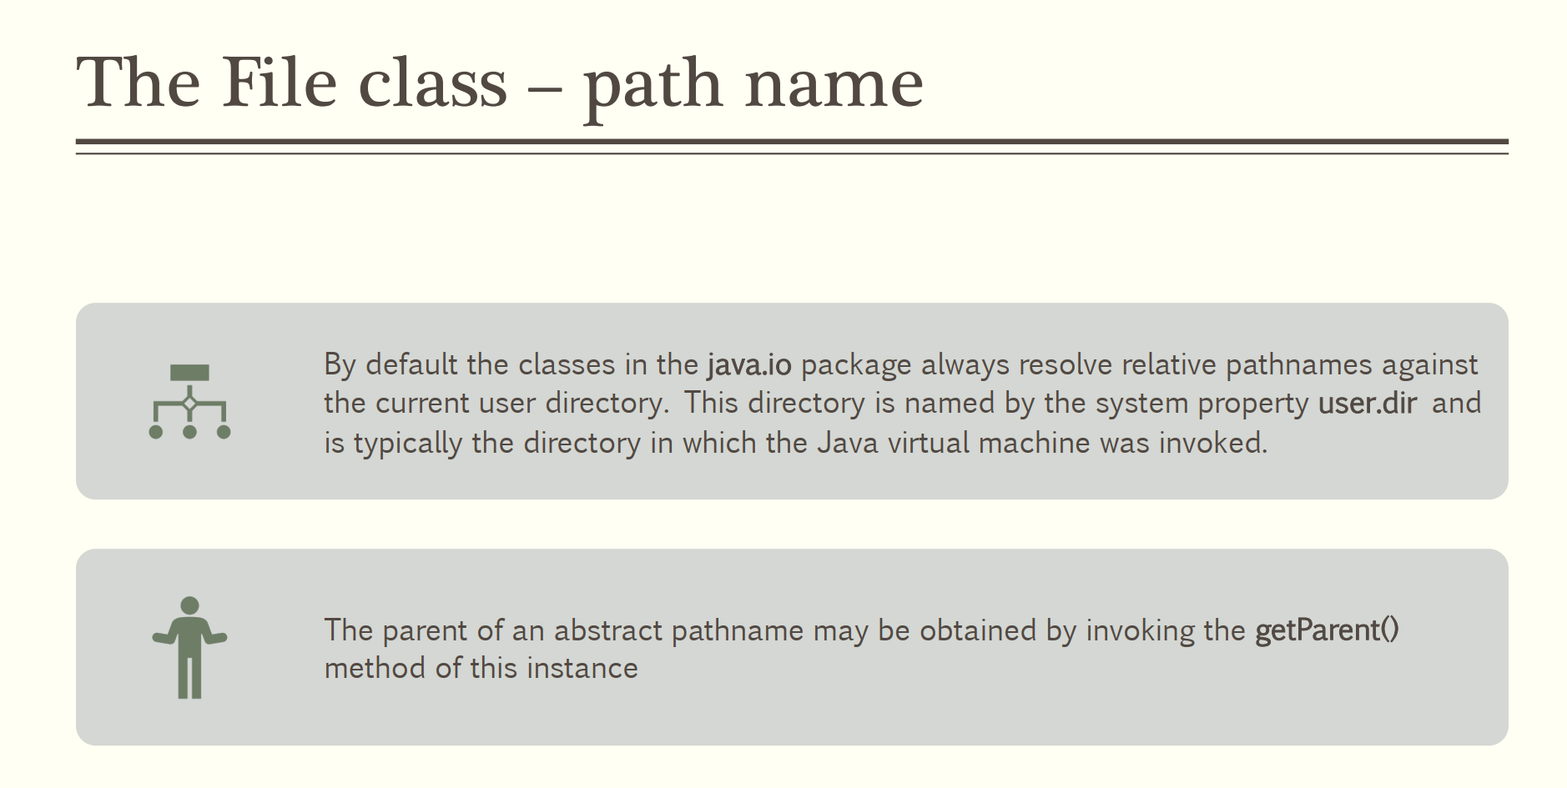

Slide 8
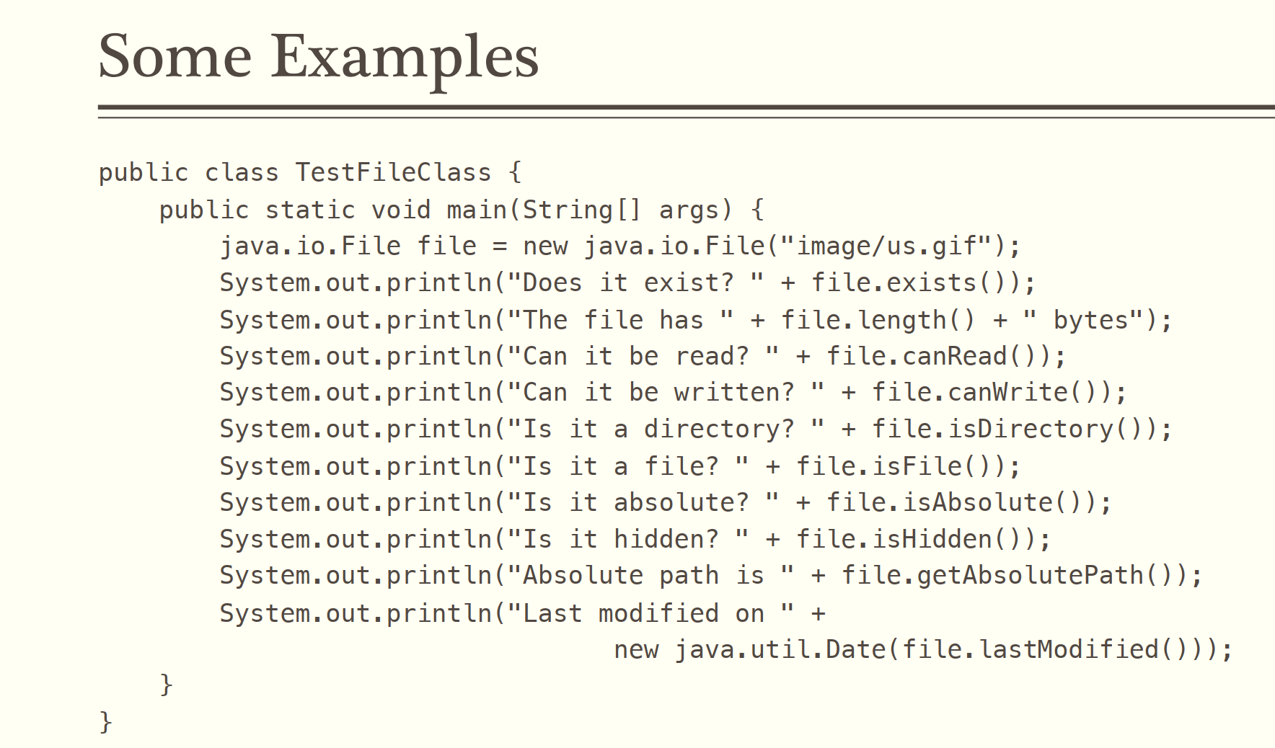
Notes:
This is an example about how to use the File class in Java.

Slide 9
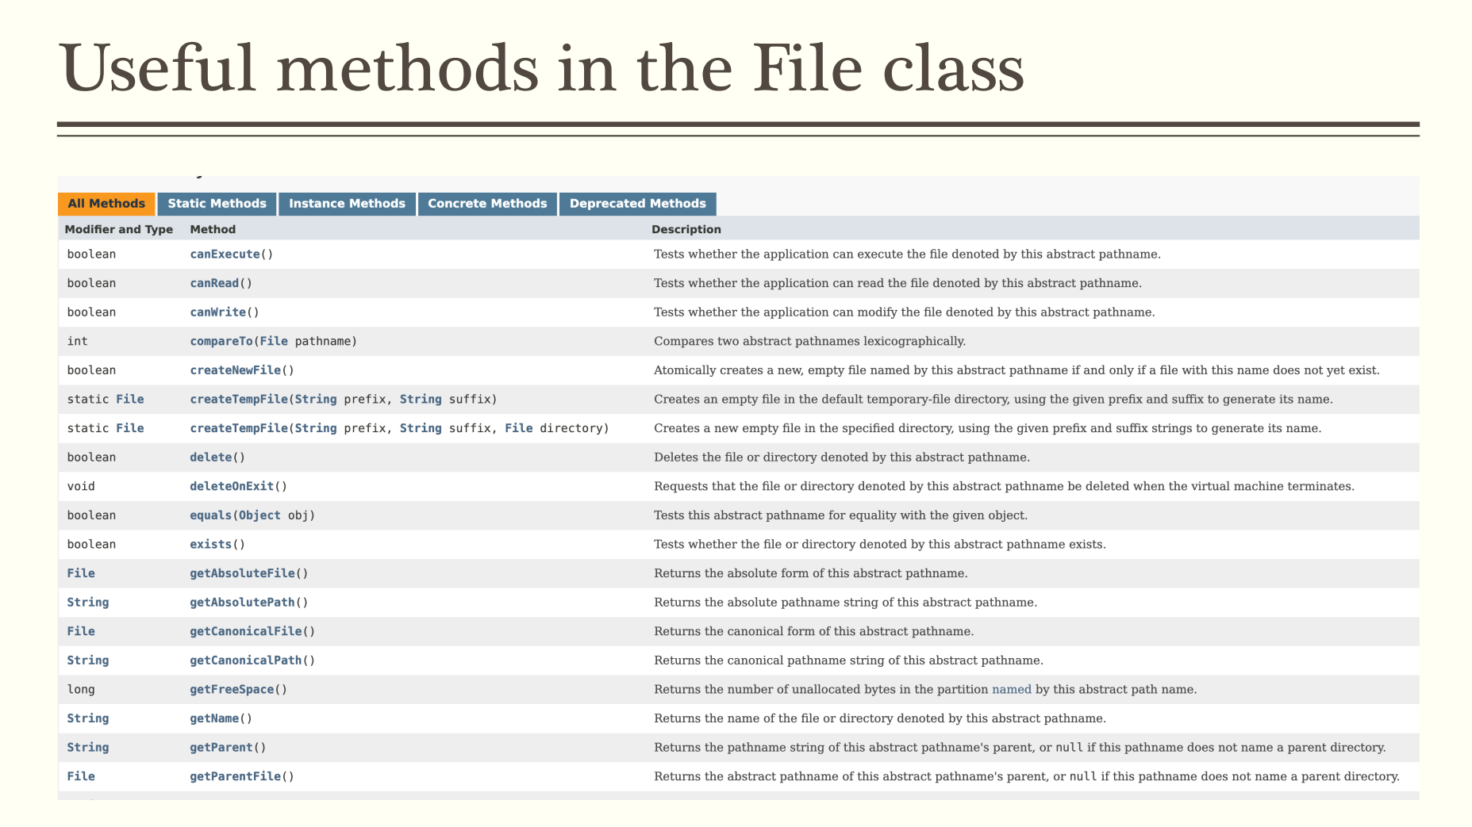
Notes:
These are useful methods in the FIle class.

Slide 10
//Using BufferedReader read char in terminal
import java.io.*;
public class BRReadLines {
public static void main(String[] args) throws IOException {
// using System.in create BufferedReader
BufferedReader br = new BufferedReader(new InputStreamReader(System.in));
String str;
System.out.println("Enter lines of text.");
System.out.println("Enter 'end' to quit.");
do {
str = br.readLine();
System.out.println(str);
} while (!str.equals("end"));
}
}
Enter lines of text.
Enter 'end' to quit.
This is line one
This is line one
This is line two
This is line two
end
end
Notes:
To read data from a file, you can use a class called BufferedReader. In this example, we read data from the system standard input, usually the console. But you can also use this method to read data from a file.

Slide 11
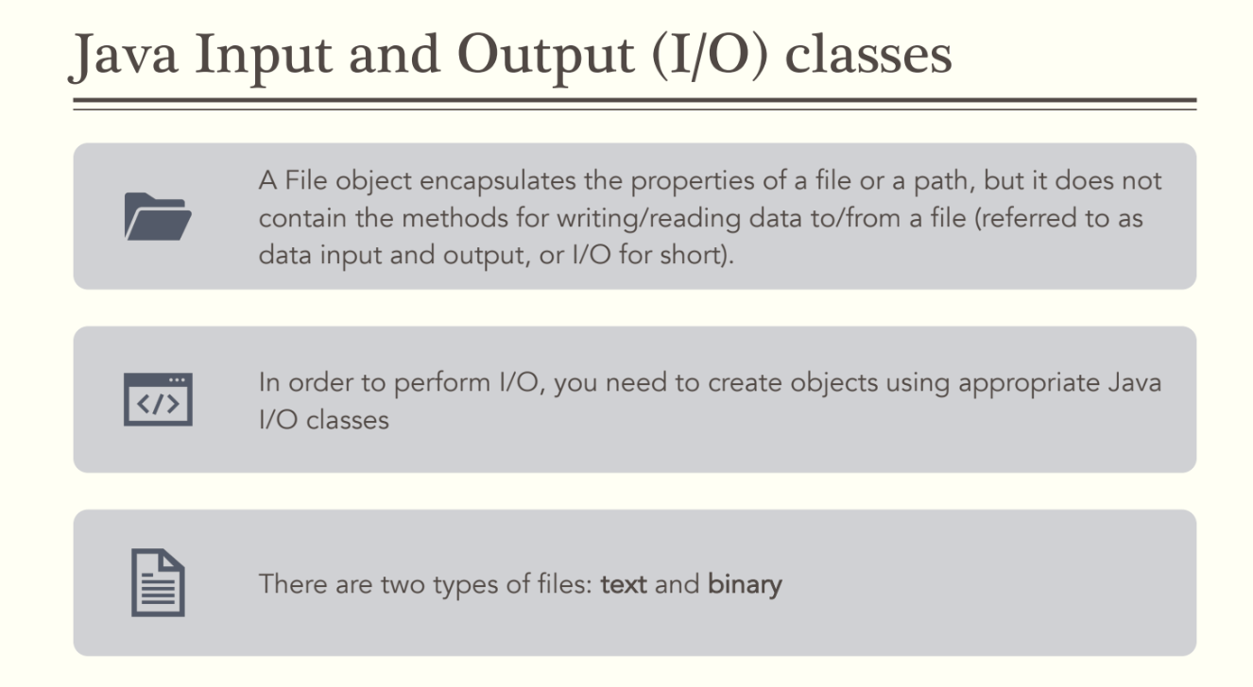

Slide 12
import java.io.*;
public class CopyFile {
public static void main(String args[]) throws IOException {
FileReader in = null;
FileWriter out = null;
try {
in = new FileReader("input.txt");
out = new FileWriter("output.txt");
int c;
while ((c = in.read()) != -1) {
out.write(c);
}
}finally {
if (in != null) {
in.close();
}
if (out != null) {
out.close();
}
}
}
}
Notes:
This is an example of how to use Java I/O class.

Slide 13

Notes:
Then, let’s talk about JavaFX. Firstly, what is JavaFX.

Slide 14
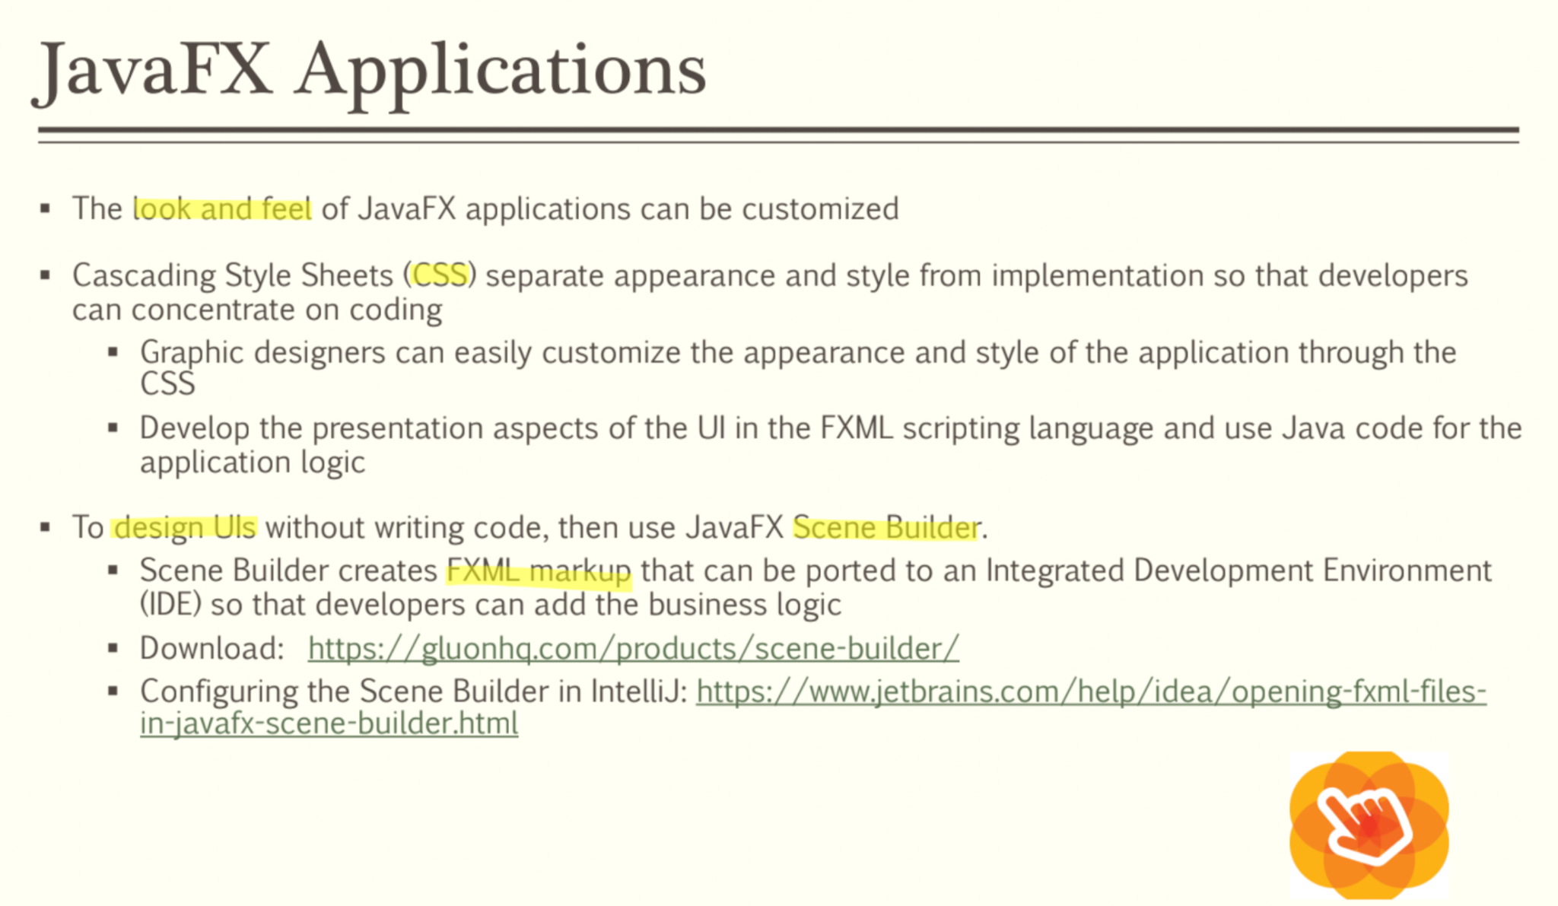

Slide 15
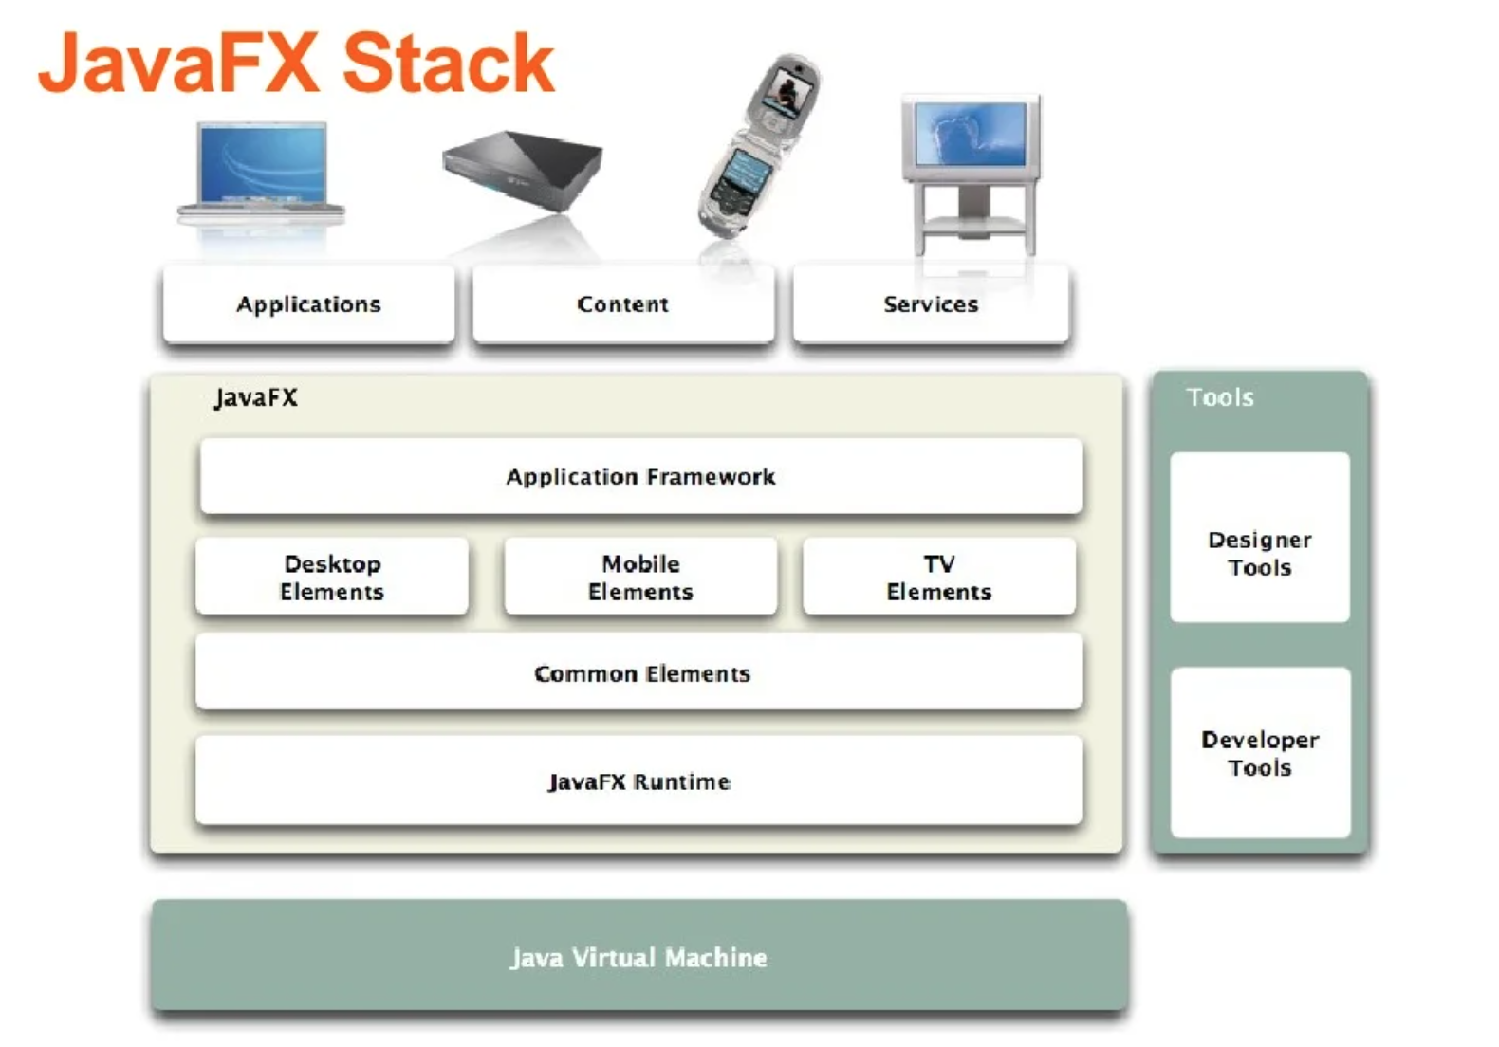
Notes:
This is the JavaFX Stack. On the bottom, it’s Java Virtual Machine.

Slide 16
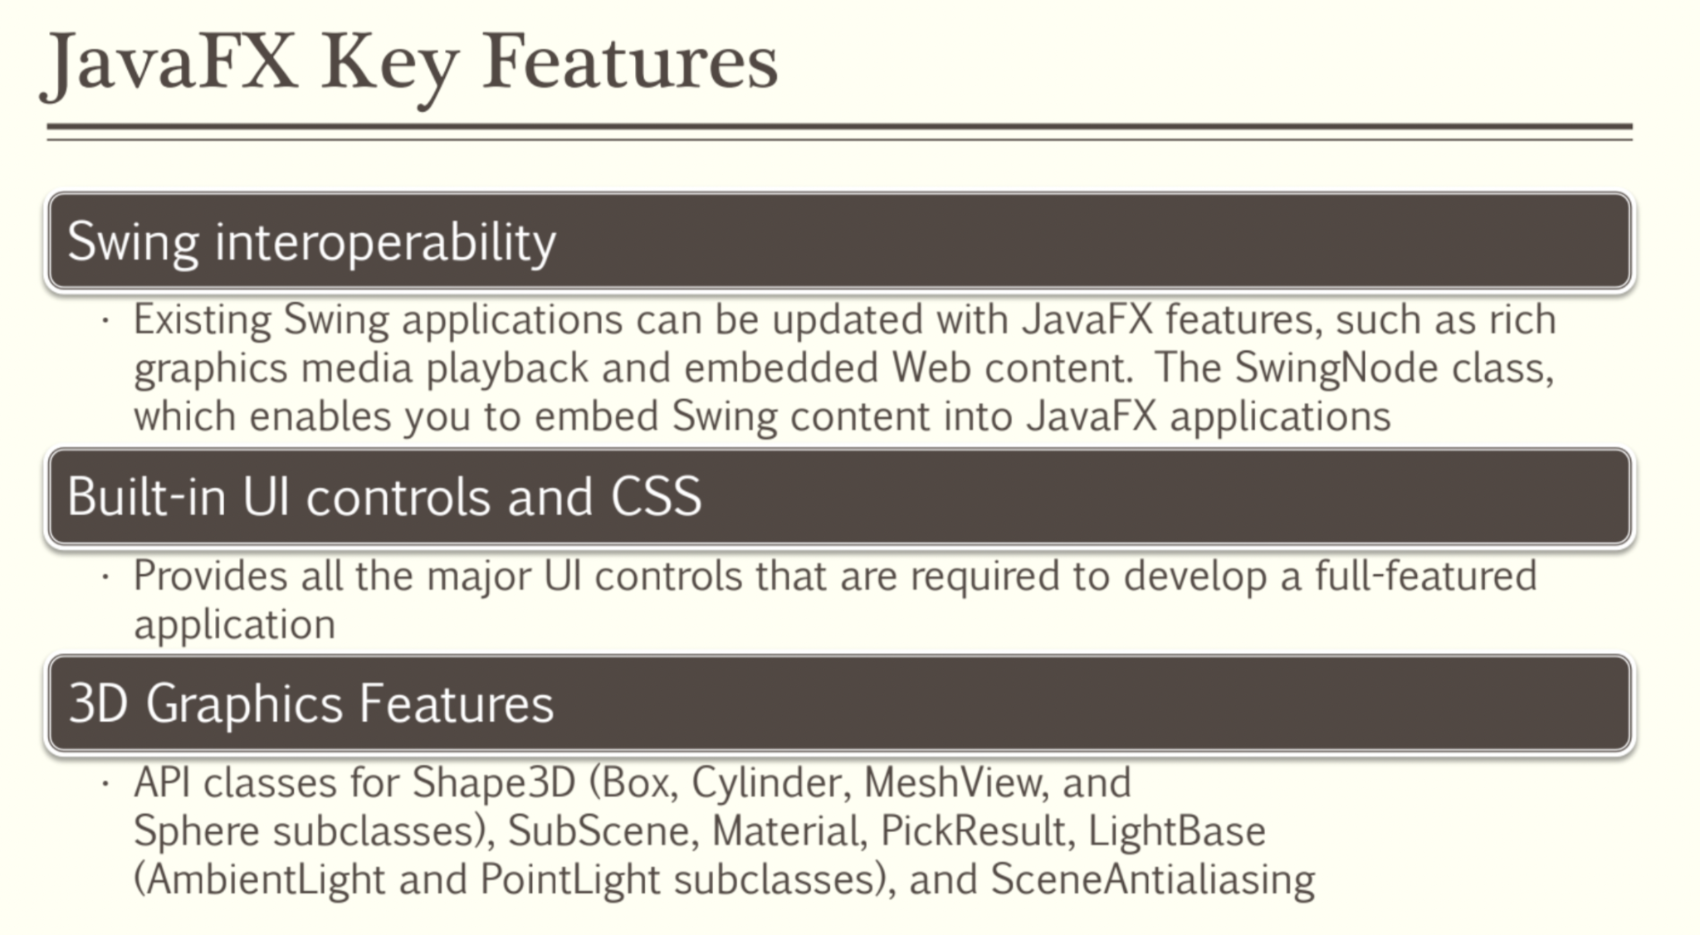

Slide 17
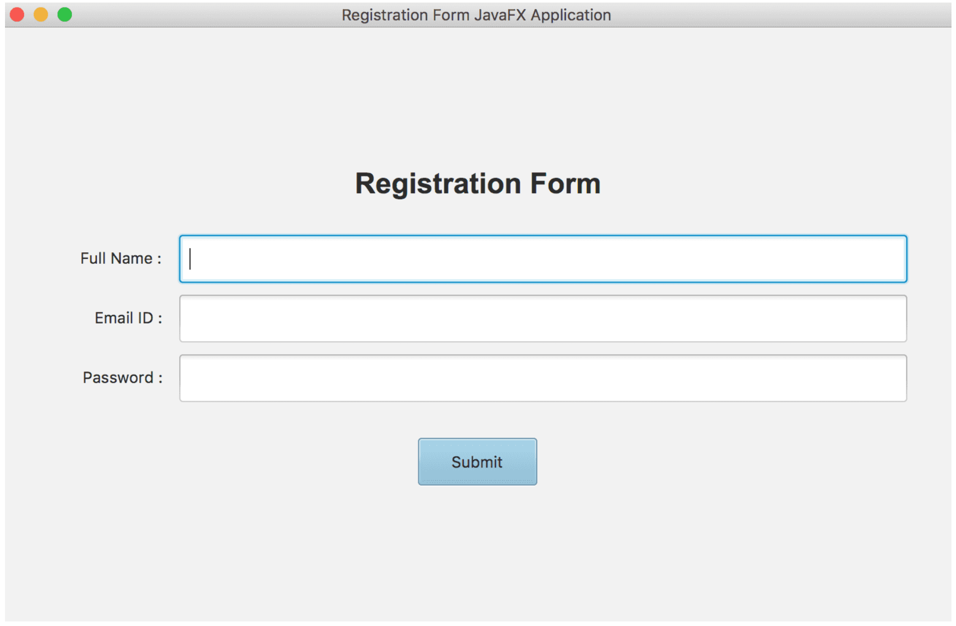
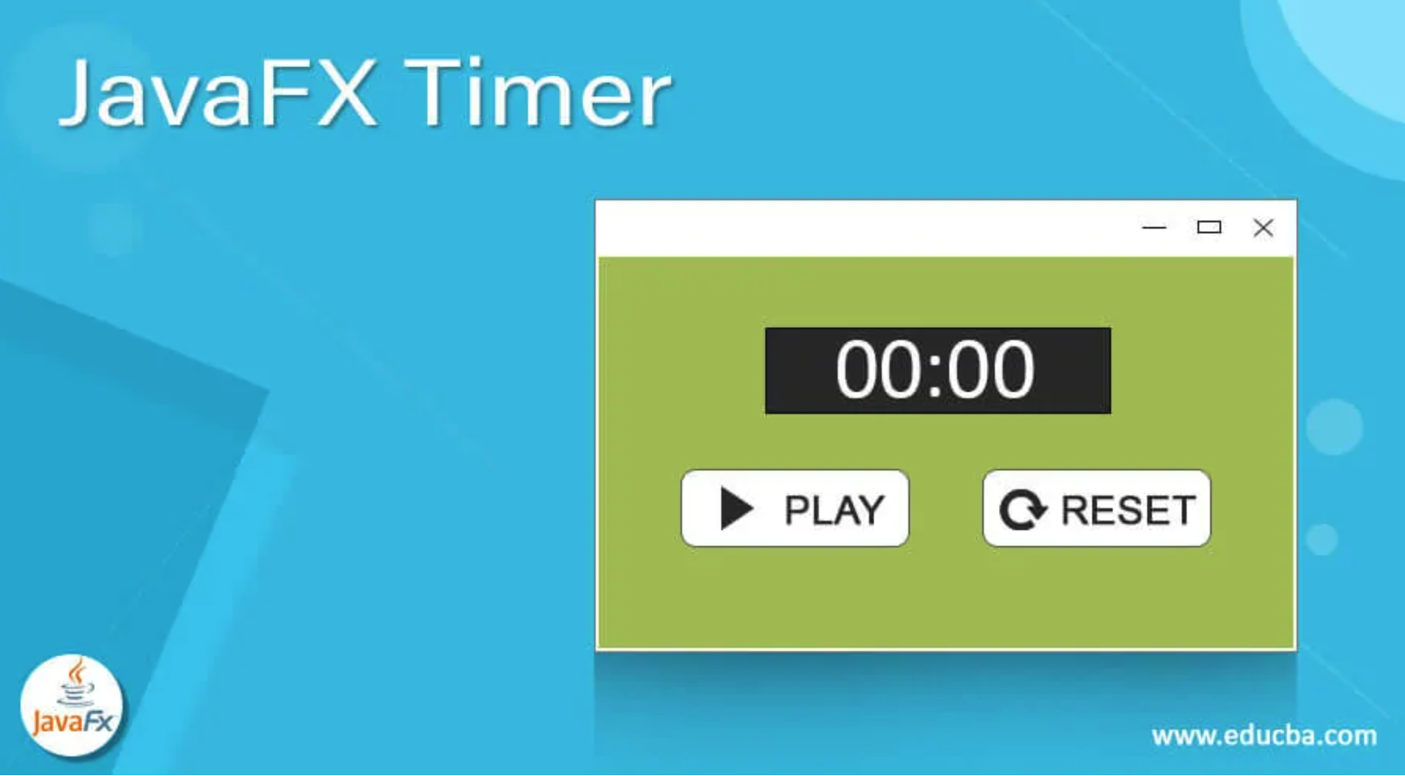
Notes:
This is an example of JavaFX‘s application.

Slide 18
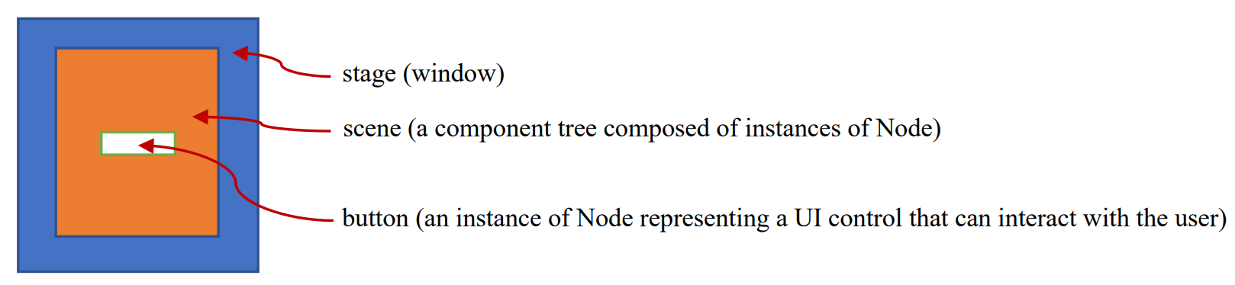
JavaFX Program Structure
javafx.application.Application class defines the essential framework for writing JavaFX programs. To construct an application, extend the Application class and override the start() method. JVM invokes the start() method when a JavaFX application is launched.
Notes:
The Scene object can be created using the constructor Scene, which defines the width and height of the scene and places the node in the scene.
The Stage object is a window. JVM will automatically create a primary stage when the application is launched. You can use the setScene method to set a scene to a stage.

Slide 19
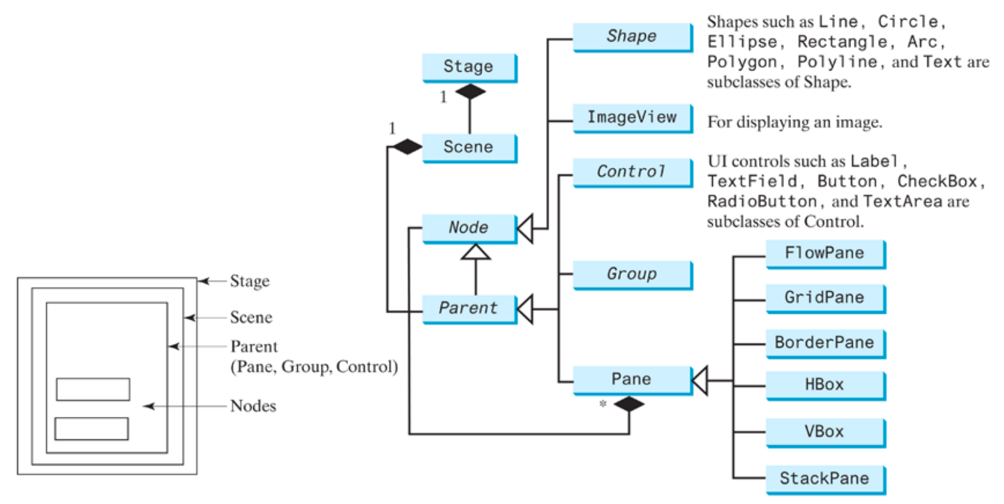
JavaFX Program Structure - Class hierarchy
Notes:
This is the class hierarchy of JavaFX.

Slide 20
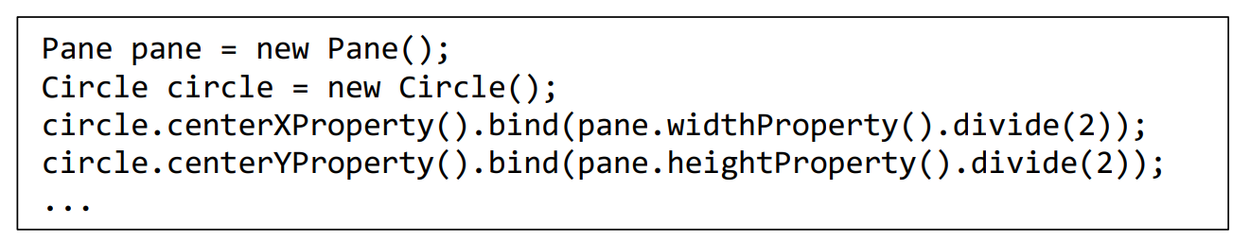
Property Binding
You can bind a target object to a source object. A change in the source object will be automatically reflected in the target object.
Notes:
You can bind a target object to a source object. A change in the source object will be automatically reflected in the target object. The target object is called a binding object or a binding property, and the source object is called a bindable object or observable object. A target listens to the changes in the source and automatically updates itself once a change is made in the source.
For example, to always show a Circle object on the center of the window whenever the window is resized, the x- and y-coordinates of the circle center need to be reset to the center of the pane. This can be done by binding the centerX with pane’s width/2 and centerY with pane’s height/2, as the code given below.

Slide 21
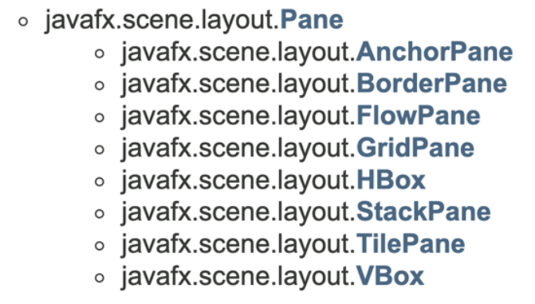
Layout Panes
Notes:
JavaFX provides many types of panes for automatically laying out nodes in a desired location and size. Here is the inheritance tree structure for the layout Panes in JavaFX Javadoc.
FlowPane arranges the nodes in the pane horizontally from left to right, or vertically from top to bottom, in the order in which they were added.
FlowPane lays out nodes row-by-row horizontally or column-by-column vertically.
GridPane arranges nodes in a grid (matrix) formation.

Slide 22
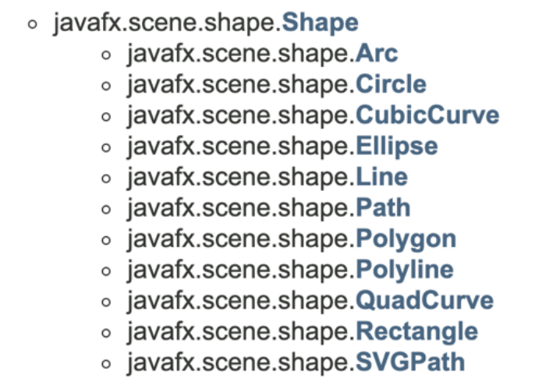
Shape
Notes:
These are the subclasses of Shape class.
The Text class defines a node that displays a string at a starting point (x, y).
A line connects two points with four parameters startX, startY, endX, and endY. The Line class defines a line.
A rectangle is defined by the parameters x, y, width, height, arcWidth, and arcHeight.
A circle is defined by its parameters centerX, centerY, and radius.
The Polygon class defines a polygon that connects a sequence of points.

